Slide 1


Faculty and Employee Association Management System (FEAMS)

Slide 2
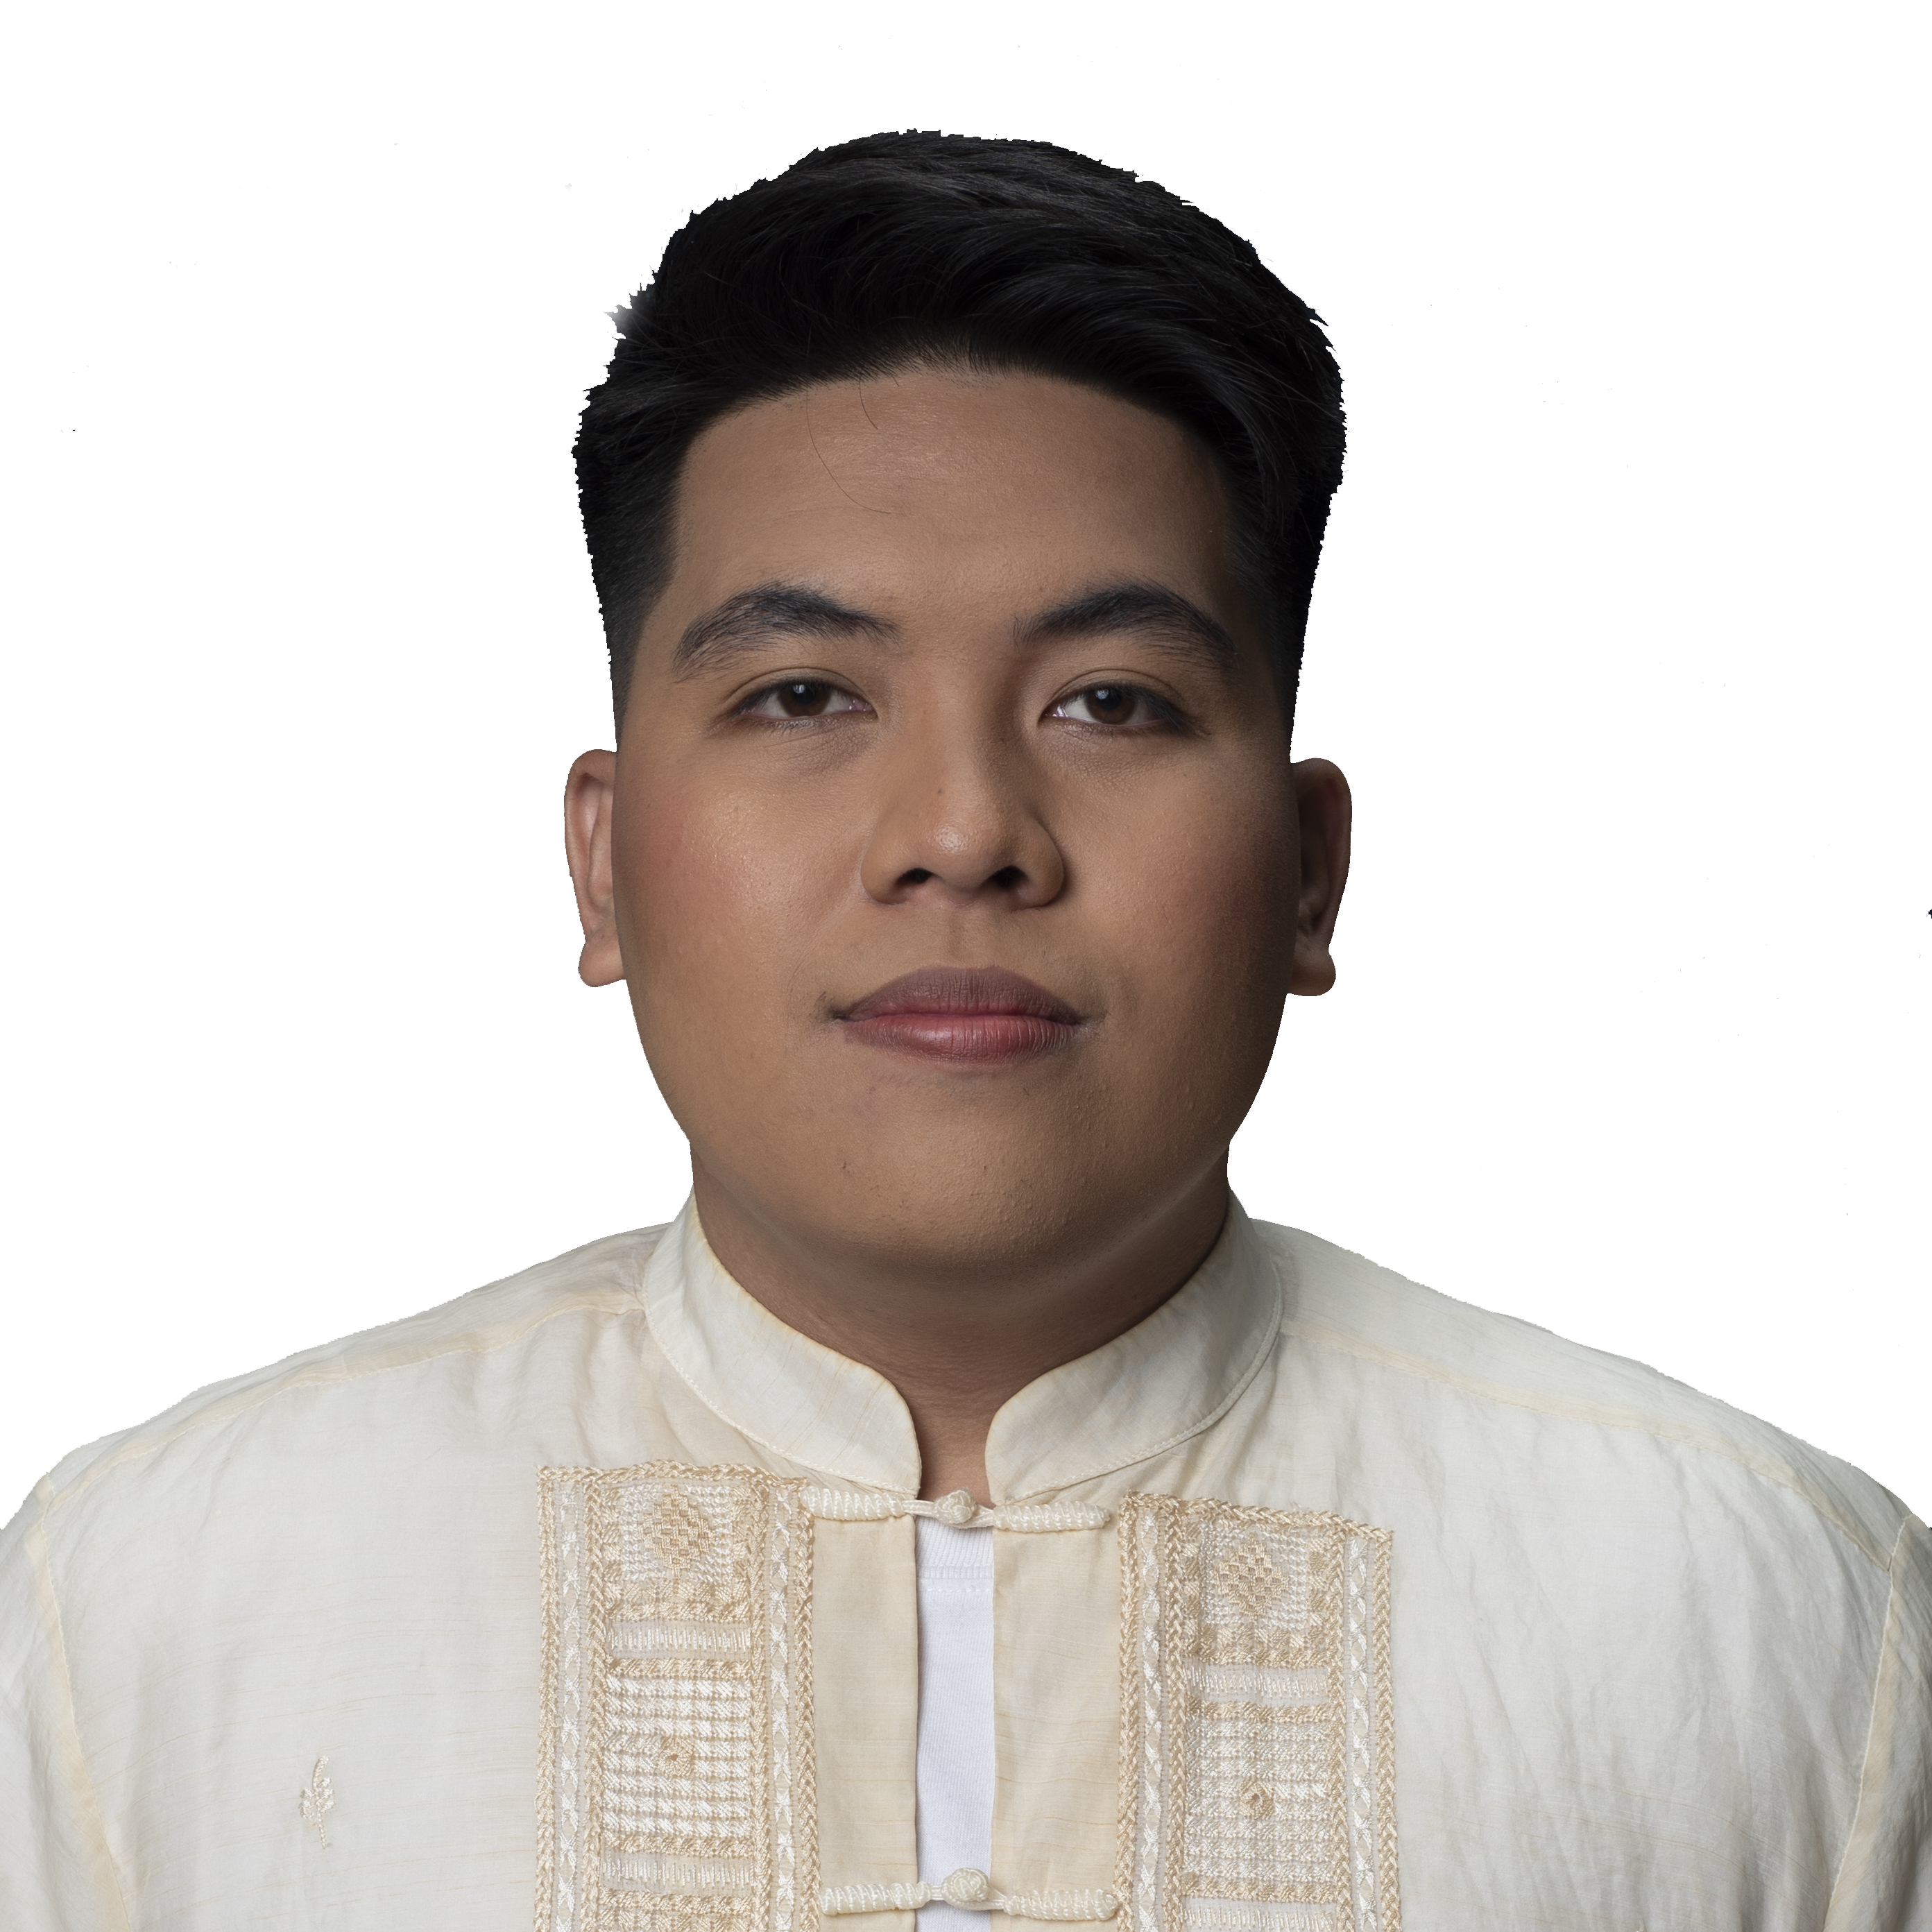
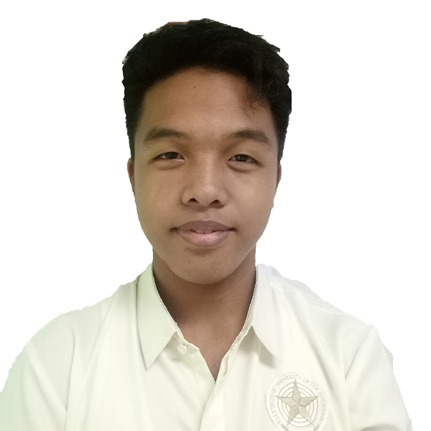
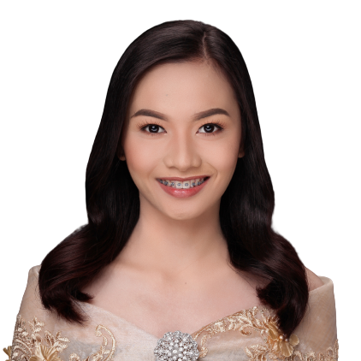
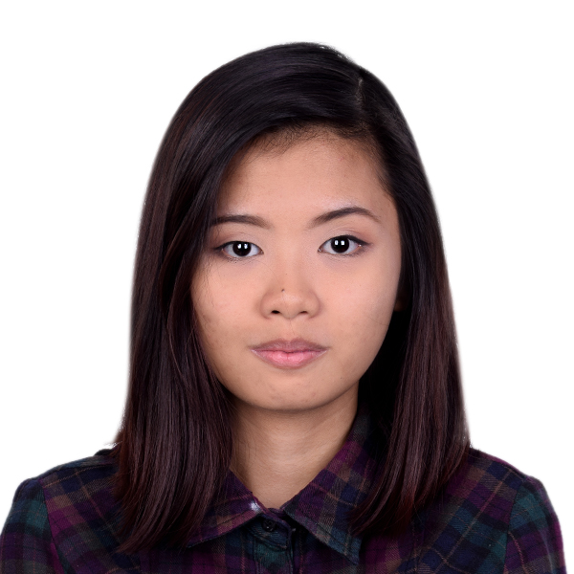
Data Driven Squad
Cariaso, Quiel Jeremiah SA & QA Tester
Lazaro, Christian Programmer
Rakim, Jasmine Document Analyst
Samar, Jamie UI Designer

Slide 3
INTRODUCTION
Associations provide support and advice to faculty and employees to help them better understand their rights and obligations in the workplace. The social, environmental development process and decision-making power of employee shall also be considered to build healthy workplace to each other.

Slide 4
OUR CLIENT
FEA is an association made for faculty members and employees within the Polytechnic University of the Philippines – Taguig Branch comprises the joint purpose of balance among teaching, research, and service.

Slide 5
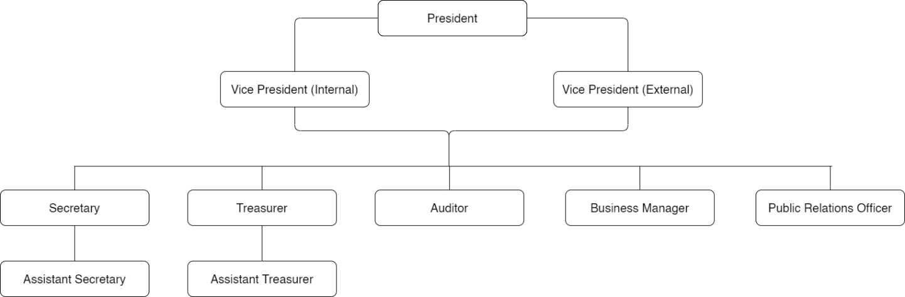
BACKGROUND OF THE ORGANIZATION

Slide 6
OBJECTIVES
Promote the welfare of faculty and employee in university.
Foster harmonious relationship/healthy environment among members.
Assist the members in regarding their concerns, needs and demand.
Promote unity and cooperation among the members toward the attainment of its objectives.
To help promote the development of a free and efficient work force with common interest and with reasonable degree of condition.

Slide 7
SCOPE AND LIMITATION
The FEAMS is mainly focused on providing an online web-based system allowing the association to track and maintain their profile, while also enabling each institution to use that data to connect work, committees, and more to better align with the association’s vision and goals.

Slide 8




CURRENT BUSINESS PROCESS
There are four software's that currently used by the association:

Slide 9
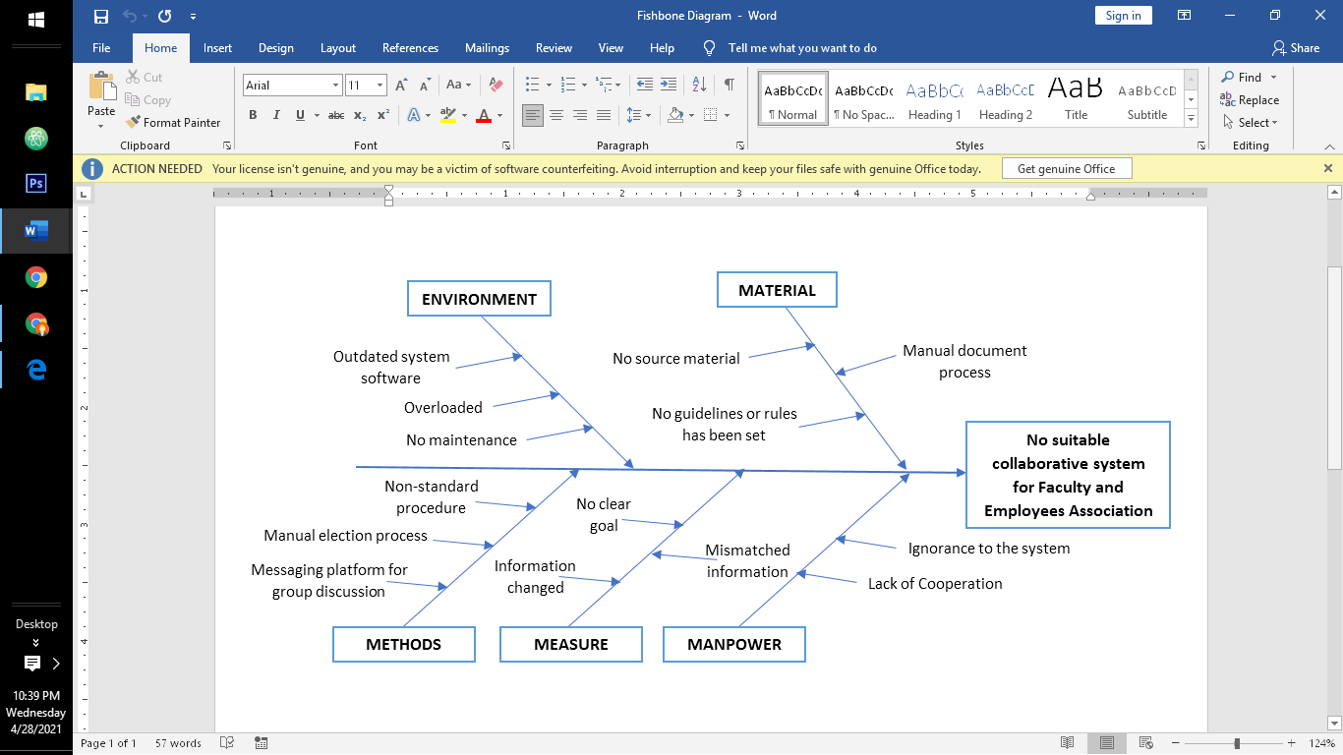
PROBLEM ANALYSIS

Slide 10
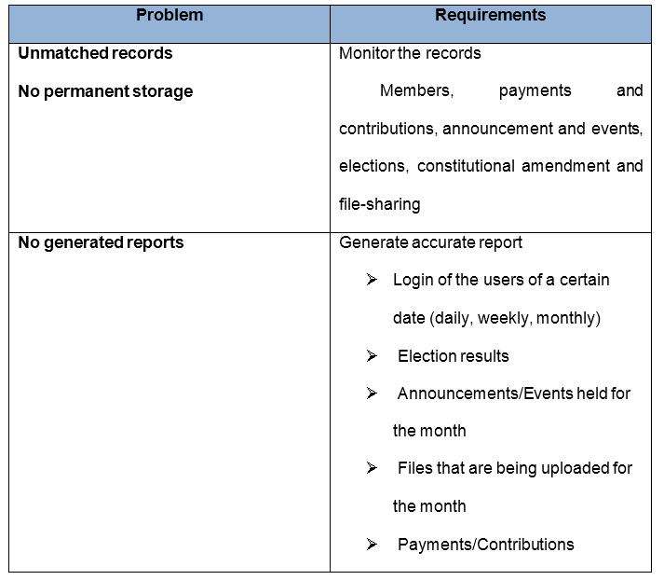
PROBLEM REQUIREMENTS

Slide 11
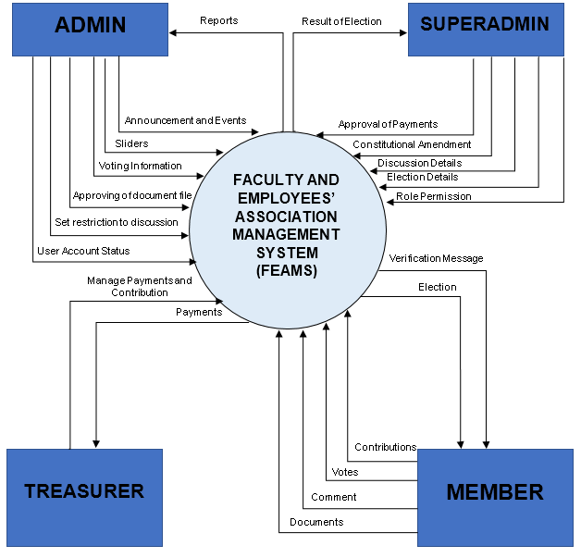
CONTEXT DIAGRAM

Slide 12
SYSTEM INFORMATION
MAINTENANCE
TRANSACTIONAL
REPORTS

Slide 13
MAINTENANCE
CRUD for members
CRUD for announcements/Events
CRUD for sliders
CRUD for files of association and members
CRUD for elections
E-mail verification of a user
Contributions
Payment Methods

Slide 14
TRANSACTIONAL
Monitoring elections that are being held
File uploading and downloading
Approving of a registered member
Login count of a user
Voting
Payments

Slide 15
REPORTS
Login of the users of a certain date
(daily, weekly, monthly)
Election results
Announcements/Events held for the month
Files that are being uploaded for the month
Payments/Contributions

Slide 16
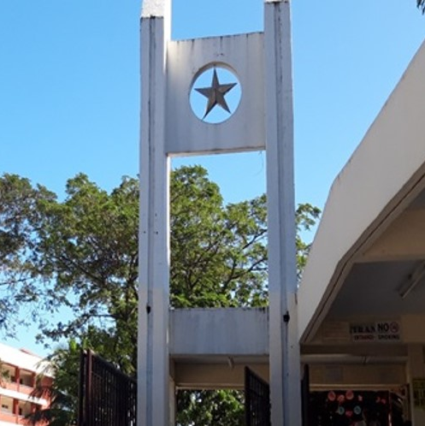
THANK YOU

